Slide 1

Single Image Super-Resolution Quality Assessment:
A Real-World Dataset, Subjective Studies, and An
Objective Metric
IEEE Transactions on Image Processing, 2022
Qiuping Jiang¹, Zhentao Liu¹, Ke Gu², Feng Shao¹,
Xinfeng Zhang³, Hantao Liu⁴, Weisi Lin⁵
1. Ningbo University, 2. Beijing University of Technology
3. University of Chinese Academy of Sciences, 4. Cardiff University
5. Nanyang Technological University

Slide 2
OUTLINE
Introduction
Background & challenge
RealSRQ: A Real-World SISR Quality Dataset
Dataset construction process
Human subjective study
Subjective study result analysis
KLTSRQA: An Objective NR Quality Metric for SISR
Motivation to apply KLT
KLTSRQA metric
Experimental Results
Validation on real-world & synthetic dataset
Conclusion

Slide 3


Introduction
Background & challenge
SR Image
Latent HR Image
LR Image
SISR
As close
Model
as possible
How to fairly compare their performance?
Non-deep Models
Interpolation-based
Reconstruction-based
Example-based
Dictionary-based
Deep Models
CNN-based
GAN-based
Flow-based
Notes:
Single image super-resolution (SISR) aims to reconstruct a latent high-resolution (HR) image from its corresponding low-resolution (LR) observation. SISR methods can be mainly divided into two categories: 1. Non-deep models: interpolation-based models, reconstruction-based models, example-based models, and dictionary-based models; 2. Deep models: CNN-based models, GAN-based models and Flow-based models. How to fairly compare the performance of different SISR algorithms remains challenging.

Slide 4
Introduction
Background & challenge
HR Image
Synthetic
LR Image
Dataset: synthetic or real-world?
Down
sampling
SISR model: how would it perform on real-world LR image?
Gap
IQA metric: can it accurately assess the SISR image quality?
Focal length
Our contribution
adjusting
Real-World
LR Image
RealSRQ & KLTSRQA
HR Image
Notes:
The key factor that distinguishes the real-world and synthetic SISR datasets is the way to obtain the LR image. In the past, researchers apply simple down sampling on the HR observation to obtain the synthetic LR counterpart. Nowadays, some researchers try to acquire real-world LR images. Cai et al [1] apply two DSLR camera (i.e., Nikon D810 and Canon 5D3) to capture various scenes in real world. Both the HR and LR images are captured by adjusting focal length at the same scene. The distortions in the real-world LR images are more complicated. How would the SISR models perform on real-world LR images? Can IQA metrics accurately assess the SISR image quality? So far, the lack of comprehensive human subjective study on large-scale real-world SISR datasets and accurate objective SISR quality assessment metrics makes it unreliable to truly understand the performance of different SISR algorithms. We try to solve it in this work from two aspects. We firstly construct a real-world SISR quality dataset (RealSRQ) with comparative human subjective studies to compare the performance of several representative SISR algorithms. Then, we propose a new objective metric, i.e., KLTSRQA, based on the Karhunen Loeve Transform (KLT) to evaluate the quality of SISR images in a no-reference (NR) manner.
Reference
[1] J. Cai, H. Zeng, H. Yong, Z. Cao, and L. Zhang, “Toward real world single image super-resolution: A new benchmark and a new model,” in 2019 IEEE/CVF International Conference on Computer Vision (ICCV), 2019, pp. 3086–3095.

Slide 5
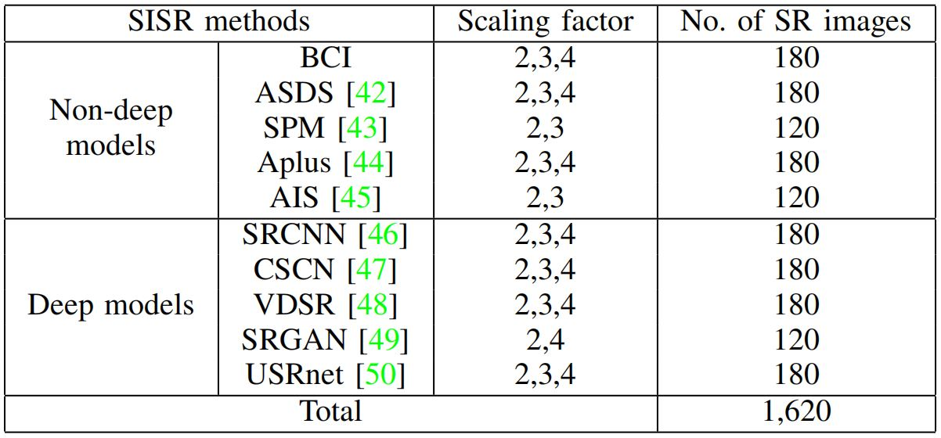
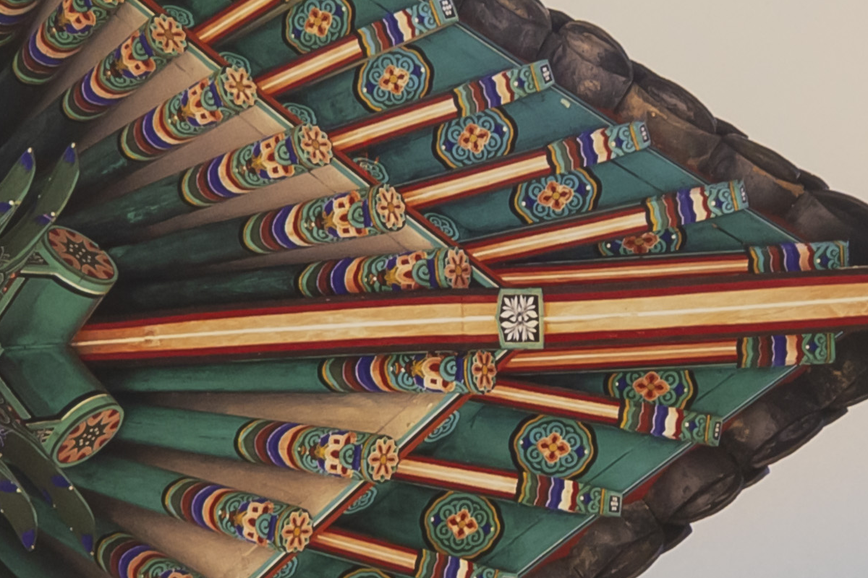

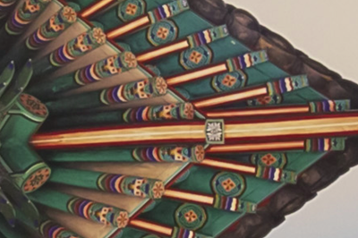
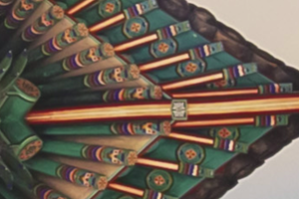
RealSRQ: A Real-World SISR Quality Dataset
Dataset construction process
HR(60)
LR2(60)
LR3(60)
LR4(60)
RealSR(53)
SR models(10)
SR models(9)
SR models(8)
Our photos(7)
SR results(600)
SR results(540)
SR results(480)
RealSR : “Toward real world single image super-resolution: A new benchmark and a new model”, ICCV 2019
Notes:
In this work, the real-world LR images are collected either from the RealSR dataset [1] (53) or captured by ourselves (7) following the same method in [1],
i.e., adjust the focal length of a fixed DSLR camera (i.e., Canon 5D3). For each scene, images are taken using four focal lengths: 105mm, 50mm, 35mm, and 28mm. Images taken by the largest focal length are used to generate the HR images, and images taken by the other three focal lengths are used to generate the three LR versions. Overall, we collect 60 HR images and corresponding 180 LR images at three different scales, including 60 for LR2, 60 for LR3, and 60 for LR4, respectively. In this study, we evaluate 10 representative SISR algorithms equally samples from the two branches, i.e., non-deep models and deep models. Finally, we get 1620 SISR images.
Reference
[1] J. Cai, H. Zeng, H. Yong, Z. Cao, and L. Zhang, “Toward real world single image super-resolution: A new benchmark and a new model,” in 2019 IEEE/CVF International Conference on Computer Vision (ICCV), 2019, pp. 3086–3095.

Slide 6
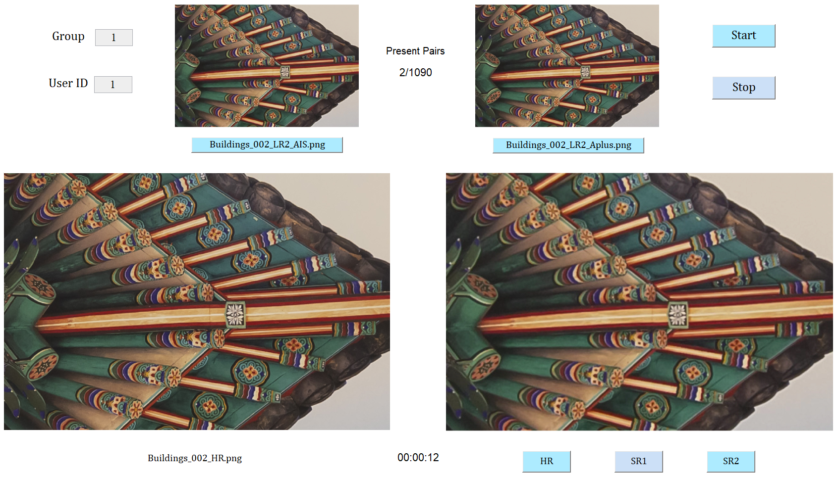
RealSRQ: A Real-World SISR Quality Dataset
Human subjective study
Pairwise comparison: which one is better?
60 subjects (32 males, 28 females), 65400 votes
Notes:
We adopt pairwise comparison in our human subjective study. 60 subjects participate in our user study, 32 males and 28 females. We divide the 60 participants into 6 groups, i.e., 10 participants per group. Each group is responsible for 10 scenes. Finally, we obtain 65400 votes.

Slide 7
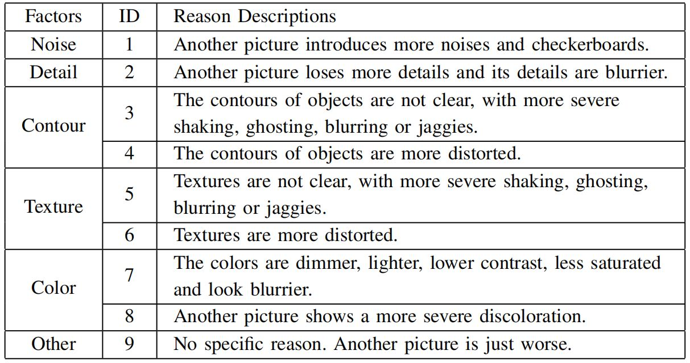
RealSRQ: A Real-World SISR Quality Dataset
Human subjective study
Additional question: why don’t you like the other picture?
To get more insights on the pros and cons of different SISR models
Notes:
To get more insights on the pros and cons of different SISR algorithms, we are also interested in asking the participants “Why don’t you like another picture?” We provide nine reasons to form the questionnaire, as shown in Table.

Slide 8
RealSRQ: A Real-World SISR Quality Dataset
Subjective study result analysis
Global ranking: Bradley-Terry model
ASDS gets the highest B-T Score at all scaling factors, USRnet gets the 2nd ranking for LR2 and LR3
ASDS : “Image deblurring and super-resolution…”, TIP 2011, USRnet : “Deep unfolding network…”, CVPR 2020
Bradley-Terry model : “Rank analysis of incomplete block designs: I. the method of paired comparisons”, Biometrika 1952
Notes:
ASDS: W. Dong, L. Zhang, G. Shi, and X. Wu, “Image deblurring and super-resolution by adaptive sparse domain selection and adaptive regularization,” IEEE Transactions on Image Processing, vol. 20, no. 7, pp. 1838–1857, 2011.
USRnet: K. Zhang, L. Van Gool, and R. Timofte, “Deep unfolding network for image super-resolution,” in 2020 IEEE/CVF Conference on Computer Vision and Pattern Recognition (CVPR), 2020, pp. 3214–3223.
Bradley-Terry model: R. A. Bradley and M. E. Terry, “Rank analysis of incomplete block designs: I. the method of paired comparisons,” Biometrika, vol. 39, no. 3/4, pp. 324–345, 1952.

Slide 9
RealSRQ: A Real-World SISR Quality Dataset
Subjective study result analysis
Convergence analysis: number of votes and images at LR4
As the number of votes and images increase, B-T Score tend to be stable

Slide 10
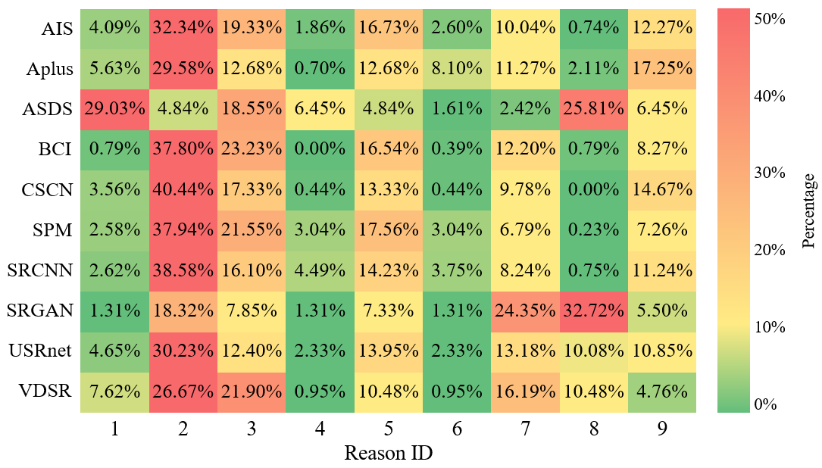
RealSRQ: A Real-World SISR Quality Dataset
Subjective study result analysis
Human preference analysis: percentage of reasons at LR4
2: Detail
3: Edge
5: Texture

Slide 11
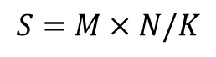
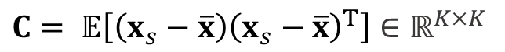
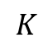

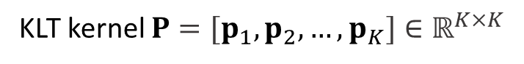
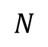
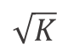


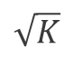
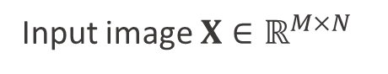

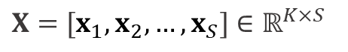
KLTSRQA: An Objective NR Quality Metric for SISR
Motivation to apply KLT: theory of KLT
$$M$$
$$\sqrt{K}$$
$$1$$
$$S=M×N/K$$
$$\sqrt{K}$$
Patch vectorize
$$N$$
$$K$$
New matrix $X$
$X=[x_{1},x_{2},…,x_{S}]$ $∈ℝ^{K×S}$
Input image $X∈ℝ^{M×N}$
Eigenvalue decomposition
Arrange eigenvector according to eigenvalue in descending order to obtain
Covariance matrix of $X$
$C= 𝔼\left[\left(x_{s}−\overline{x}\right){\left(x_{s}−\overline{x}\right)}^{T}\right]$ $∈ℝ^{K×K}$
KLT kernel $P=[p_{1},p_{2},…,p_{K}]∈ℝ^{K×K}$
KLT coefficient matrix $Y=P^{T}X={[y_{1},y_{2},…,y_{K}]}^{T}$ $∈ℝ^{K×S}$, $y_{k}∈ℝ^{S}$ is the $k$-th spectral component in $Y$.

Slide 12
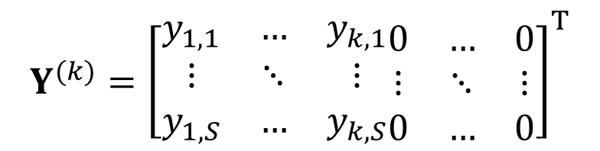
KLTSRQA: An Objective NR Quality Metric for SISR
Motivation to apply KLT: relationship between KLT and SISR IQA
KLT kernel $P$ is an orthogonal matrix, thus $PP^{T}=I$, original image can be reconstructed as $X=PY$.
Take the first $k$ spectral components to obtain reconstruction KLT coefficient matrix $Y^{(k)}$ as follows:
$$Y^{(k)}={\left[\begin{matrix}y_{1,1} & … & y_{k,1} \\ ⋮ & ⋱ & ⋮ \\ y_{1,S} & … & y_{k,S}\end{matrix}\begin{matrix}0 & … & 0 \\ ⋮ & ⋱ & ⋮ \\ 0 & … & 0\end{matrix}\right]}^{T}$$
The image is reconstructed as $X^{(k)}=PY^{(k)}$ by only considering the first $k$ spectral components. And here we adopt $K=64$.

Slide 13
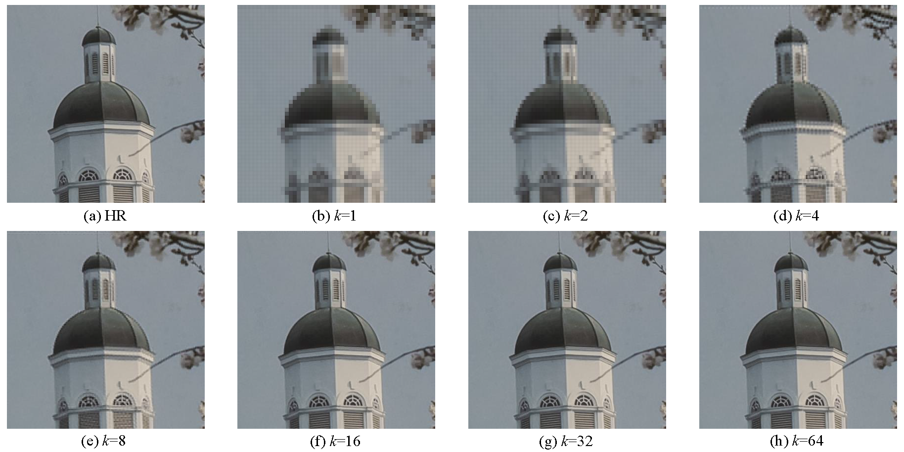
KLTSRQA: An Objective NR Quality Metric for SISR
Motivation to apply KLT: relationship between KLT and SISR IQA
Image reconstruction: as $k$ increase, the reconstructed image become finer
Notes:
(b): When only the 1st spectral component is involved in the reconstruction process, almost all the structures are recovered.
As k increases, the small textures and details become richer and clearer.
(f): When k=16 the reconstructed image is almost equal to the original one, i.e., (a)

Slide 14
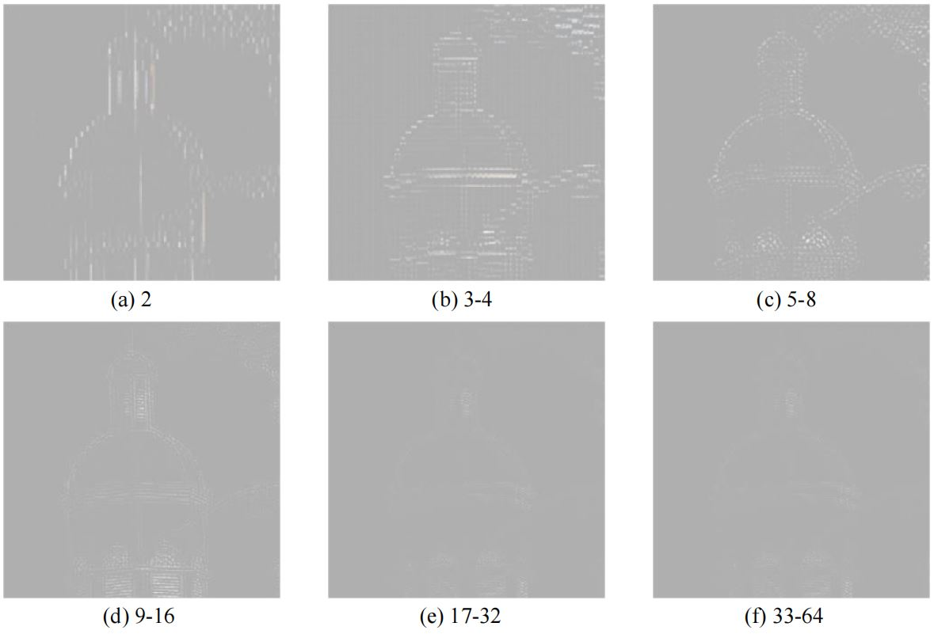
KLTSRQA: An Objective NR Quality Metric for SISR
Motivation to apply KLT: relationship between KLT and SISR IQA
Difference map: the former, more coarse; the latter, the finer
Notes:
The difference maps between the adjacent reconstruction results.
(a) refers to the difference map between reconstruction result (b) and (c) (last slide), and is exactly the reconstruction result by only using the 2nd spectral component.
(a)(b)(c) contain some basic contours and edges while (d)(e)(f) only contain some extremely small details. In other words, we can say that the front part of spectral components in the KLT coefficient matrix accounts for the reconstruction of image macro-structures such as the basic contour and main structures while the latter part of spectral components accounts for the reconstruction of image micro-structures such as the small textures and details. The distortions on macro-structures (e.g., edges and contours) and micro-structures (e.g., texture and details) are the main factors affecting the visual quality of SISR results. Thus, by specifying different spectral components, KLT provides an effective way to characterize the underlying SISR image distortions from different image components (i.e., macro-structures and micro-structures).

Slide 15
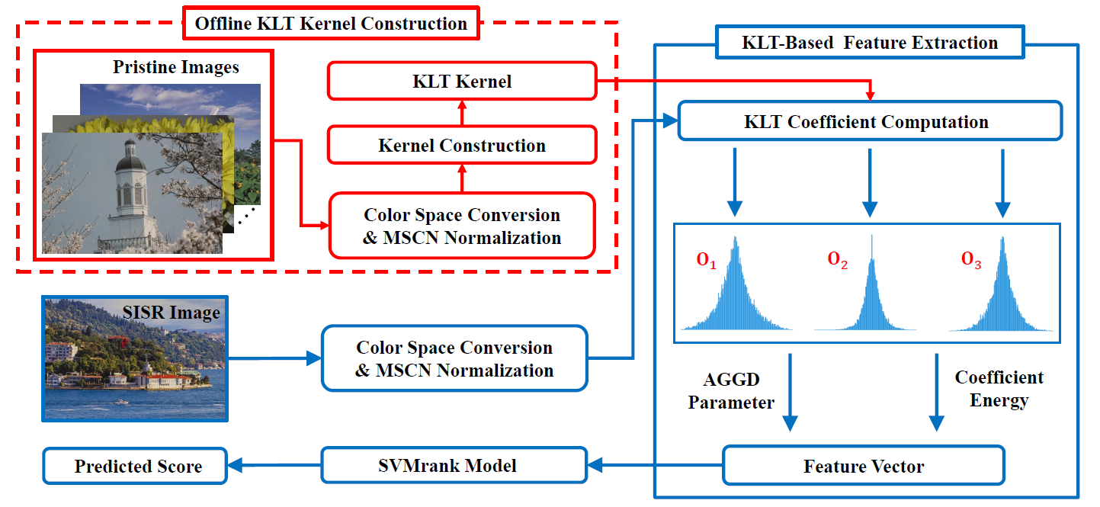
KLTSRQA: An Objective NR Quality Metric for SISR
KLTSRQA metric: overview
KLTSRQA: flow chart
Notes:
Using the characteristics of different spectral components in KLT coefficient matrix, we propose the KLTSRQA metric.
Test stage: The input SISR image is first converted into opponent color space and then perform MSCN[1] operation. The KLT is performed on the MSCN maps using the KLT kernels that have been constructed offline. We estimated AGGD[2] parameters and the energy of KLT coefficients from the KLT coefficient matrix as the image quality aware features. Finally, we apply SVMrank[3] regression model to obtain the final predicted score.
Offline KLT kernel construction: Each pristine image is first converted into opponent color space and then perform MSCN[1] operation. All the MSCN maps are combined together to obtain the KLY kernel.
Reference
[1] A. Mittal, A. K. Moorthy, and A. C. Bovik, “No-reference image quality assessment in the spatial domain,” IEEE Transactions on Image Processing, vol. 21, no. 12, pp. 4695–4708, 2012.
[2] K. Sharifi and A. Leon-Garcia, “Estimation of shape parameter for generalized gaussian distributions in subband decompositions of video,” IEEE Transactions on Circuits and Systems for Video Technology, vol. 5, no. 1, pp. 52–56, 1995.
[3] T. Joachims, “Training linear svms in linear time,” ACM SIGKDD International Conference on Knowledge Discovery and Data Mining, 2006.

Slide 16

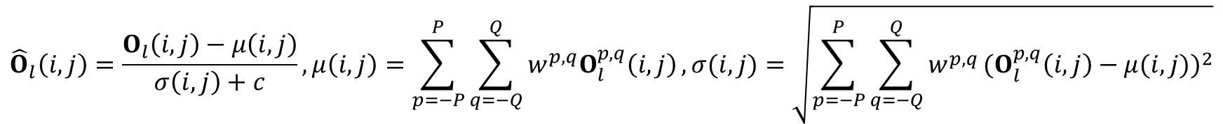
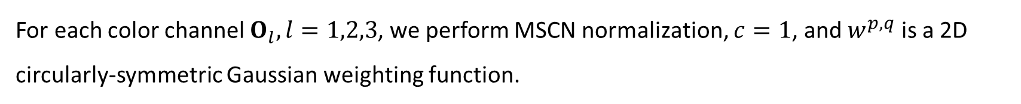
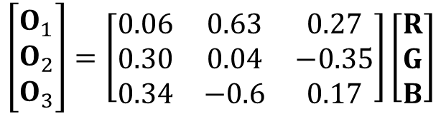
KLTSRQA: An Objective NR Quality Metric for SISR
KLTSRQA metric: color space conversion & MSCN normalization
The input image $X$ in RGB color space is first converted into opponent color space.
$$\left[\begin{matrix}O_{1} \\ O_{2} \\ O_{3}\end{matrix}\right]=\left[\begin{matrix}0.06 & 0.63 & 0.27 \\ 0.30 & 0.04 & −0.35 \\ 0.34 & −0.6 & 0.17\end{matrix}\right]\left[\begin{matrix}R \\ G \\ B\end{matrix}\right]$$
For each color channel $O_{l}, l=1,2,3$, we perform MSCN normalization, $c=1$, and $w^{p,q}$ is a 2D circularly-symmetric Gaussian weighting function.
$${\hat{O}}_{l}\left(i,j\right)=\frac{O_{l}\left(i,j\right)−μ\left(i,j\right)}{σ\left(i,j\right)+c},μ\left(i,j\right)=\sum_{p=−P}^{P}{\sum_{q=−Q}^{Q}{w^{p,q}O_{l}^{p,q}\left(i,j\right)}},σ(i,j)=\sqrt{\sum_{p=−P}^{P}{\sum_{q=−Q}^{Q}{w^{p,q}}}{(O_{l}^{p,q}\left(i,j\right)−μ(i,j))}^{2}}$$
And then KLT is applied on each MSCN map ${\hat{O}}_{l},Y_{l}={P_{l}}^{T}{\hat{O}}_{l}, l=1,2,3$, $P_{l}$ is the KLT kernel we have constructed offline.
MSCN : “No-reference image quality assessment in the spatial domain”, TIP 2012
Notes:
MSCN: A. Mittal, A. K. Moorthy, and A. C. Bovik, “No-reference image quality assessment in the spatial domain,” IEEE Transactions on Image Processing, vol. 21, no. 12, pp. 4695–4708, 2012.

Slide 17
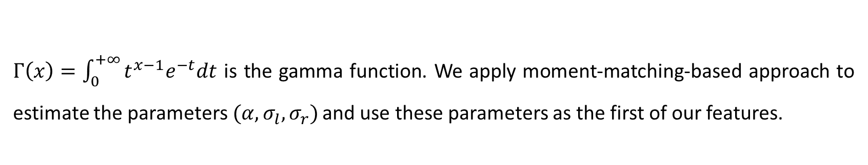
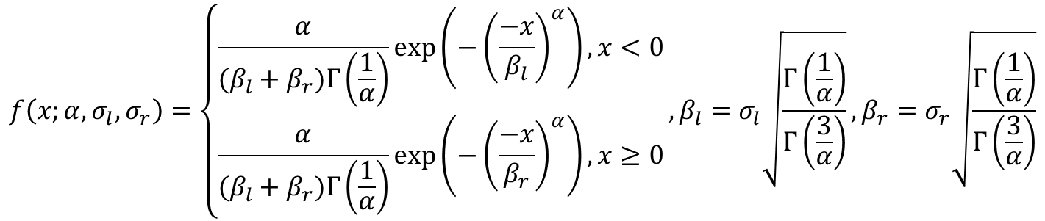
KLTSRQA: An Objective NR Quality Metric for SISR
KLTSRQA metric: KLT-based feature extraction
Estimated AGGD parameters
The probability density function of AGGD with zero mode is defined as follows:
$$f\left(x;α,σ_{l},σ_{r}\right)=\left\{\begin{aligned}\frac{α}{(β_{l}+β_{r})Γ\left(\frac{1}{α}\right)}\exp\left(−{\left(\frac{−x}{β_{l}}\right)}^{α}\right), x<0 \\ \frac{α}{(β_{l}+β_{r})Γ\left(\frac{1}{α}\right)}\exp\left(−{\left(\frac{−x}{β_{r}}\right)}^{α}\right), x≥0\end{aligned}\right.,β_{l}=σ_{l}\sqrt{\frac{Γ\left(\frac{1}{α}\right)}{Γ\left(\frac{3}{α}\right)}},β_{r}=σ_{r}\sqrt{\frac{Γ\left(\frac{1}{α}\right)}{Γ\left(\frac{3}{α}\right)}}$$
$Γ\left(x\right)=\int_{0}^{+∞}{t^{x−1}e^{−t}dt}$ is the gamma function. We apply moment-matching-based approach to estimate the parameters$(α,σ_{l},σ_{r})$ and use these parameters as the first of our features.
moment-matching-based approach : “Multiscale skewed heavy tailed model for texture analysis”, ICIP 2009
Notes:
moment-matching-based approach: N. Lasmar, Y. Stitou, and Y. Berthoumieu, “Multiscale skewed heavy tailed model for texture analysis,” in 2009 16th IEEE International Conference on Image Processing (ICIP), 2009, pp. 2281–2284

Slide 18
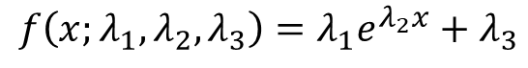
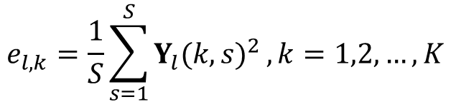
KLTSRQA: An Objective NR Quality Metric for SISR
KLTSRQA metric: KLT-based feature extraction
Energy of KLT coefficients
The energy of KLT coefficients in each spectral component is defined as follows:
$$e_{l,k}=\frac{1}{S}\sum_{s=1}^{S}{Y_{l}{(k,s)}^{2}}, k=1,2,…,K$$
We use the exponential function to fit the energy distribution, $λ_{1},λ_{2},λ_{3}$ are the parameters to fit.
$$f\left(x;λ_{1},λ_{2},λ_{3}\right)=λ_{1}e^{λ_{2}x}+λ_{3}$$
We resort to sample the fitted curve and use the sampled discrete value as our second part of features. Finally, we apply SVMrank model to get our predicted score.
SVMrank : “Training linear svms in linear time”, SIGKDD 2006
Notes:
SVMrank: T. Joachims, “Training linear svms in linear time,” ACM SIGKDD International Conference on Knowledge Discovery and Data Mining, 2006.

Slide 19
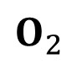
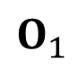
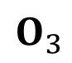
KLTSRQA: An Objective NR Quality Metric for SISR
KLTSRQA metric: KLT-based feature extraction
Estimated AGGD parameters: scatter plot
$$O_{1}$$
$$O_{2}$$
$$O_{3}$$
Estimated AGGD parameters in different visual quality images separate with each other

Slide 20
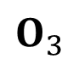
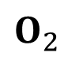
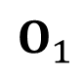
KLTSRQA: An Objective NR Quality Metric for SISR
KLTSRQA metric: KLT-based feature extraction
Energy of KLT coefficient: curve plot
$$O_{1}$$
$$O_{2}$$
$$O_{3}$$
Curve of energy in different visual quality images separate with each other

Slide 21
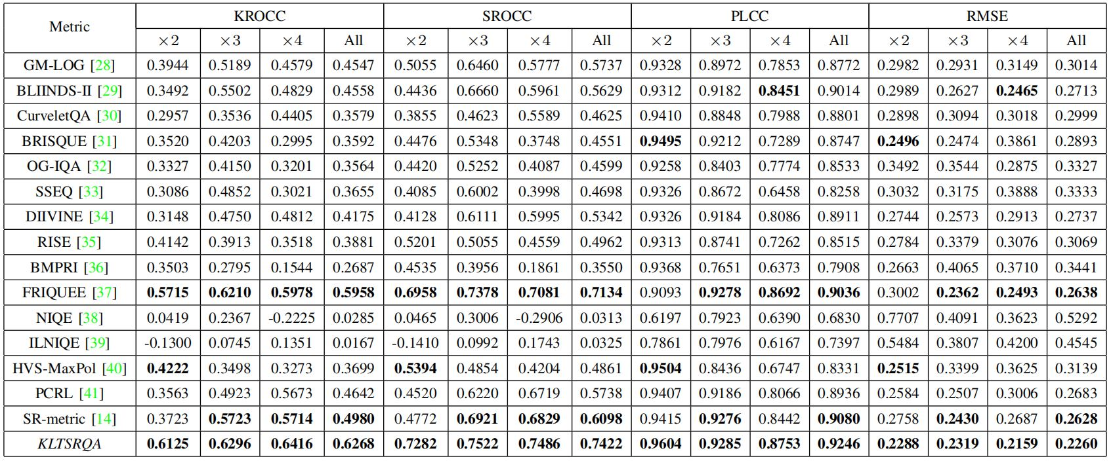
Experimental Results
Validation on real-world & synthetic dataset
Performance comparison on RealSRQ
KLTSRQA rank 1st in each scaling factor on KROCC, SROCC, PLCC, RMSE
Notes:
“All” column is the SR image number weighted value. LR2: 600 SR images, LR3: 540 SR images, LR4: 480 SR images.

Slide 22
Experimental Results
Validation on real-world & synthetic dataset
Scatters between subjective scores and metrics on RealSRQ
KLTSRQA is the most in line with the subjective scores

Slide 23
Experimental Results
Validation on real-world & synthetic dataset
T-test on SROCC value between metrics on RealSRQ
KLTSRQA outperforms other metrics
Notes:
The value 1/-1 indicates that row algorithms perform statistically better/worse than the column algorithms while the value 0 indicates that row algorithms perform statistically competitive with the column algorithms. It can be observed that KLTSRQA outperforms all the other metrics.

Slide 24
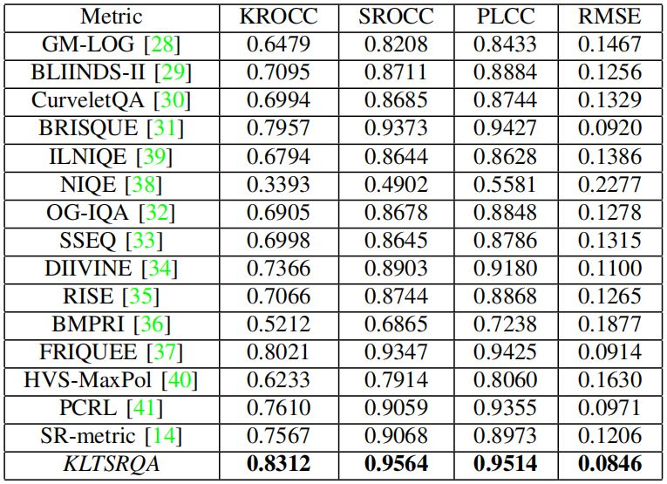
Experimental Results
Validation on real-world & synthetic dataset
Performance comparison on QADS
KLTSRQA rank 1st in each scaling factor on KROCC, SROCC, PLCC, RMSE
QADS : “Visual quality assessment for super-resolved images: Database and method”, TIP 2019
Notes:
QADS: F. Zhou, R. Yao, B. Liu, and G. Qiu, “Visual quality assessment for super-resolved images: Database and method,” IEEE Transactions on Image Processing, vol. 28, no. 7, pp. 3528–3541, 2019.

Slide 25
Experimental Results
Validation on real-world & synthetic dataset
Scatters between subjective scores and metrics on QADS
KLTSRQA is the most in line with the subjective scores

Slide 26
Experimental Results
Validation on real-world & synthetic dataset
T-test on SROCC value between metrics on QADS
KLTSRQA outperforms other metrics

Slide 27
Conclusion
This paper focuses on the problem of perceptual quality assessment of real-world SISR, we make the following two aspects of contributions:
We construct the first real-world SISR quality dataset RealSRQ and conduct comparative human subjective studies with representative SISR models.
We propose a new objective metric KLRSRQA to evaluate the quality of SISR images in a NR manner. Experiments on real-world & synthetic dataset demonstrate our metric’s superiority.
The dataset and the code are available at https://github.com/Zhentao-Liu/
RealSRQ-KLTSRQA. For more detail, please refer to our paper.

